Slide 1

A Risk Assessment and Legal Compliance Framework for Supporting Personal Data Sharing with Privacy Preservation for Scientific Research
This framework provides a roadmap for responsible and ethical data sharing, enabling valuable insights while safeguarding individual privacy.
Abhinavkumar Yadav
24CO1011

Slide 2

The importance of personal data sharing for scientific research
1
Accelerated Discovery
2
Improved Outcomes
Data sharing enables researchers to collaborate and pool resources, driving faster discoveries and innovation.
Large datasets allow for more robust analysis and insights, leading to better understanding of complex phenomena.
3
Greater Impact
Findings from shared data can translate into tangible benefits, such as new treatments or policy improvements.

Slide 3
Risks and challenges in personal data sharing
Privacy Violations
Security Breaches
Data Misuse
Unauthorized access or misuse of personal data can lead to harm and reputational damage.
Sensitive information can be compromised through cyberattacks or vulnerabilities in data storage.
Data may be used for purposes other than intended or for discriminatory practices.

Slide 4

Regulatory landscape and legal compliance requirements
Regulation
Key Provisions
GDPR
Data subject rights, consent requirements, data protection by design
HIPAA
Protected health information (PHI) safeguards, patient privacy, data security
CCPA
Consumer data privacy, right to know, right to delete, data breach notification

Slide 5
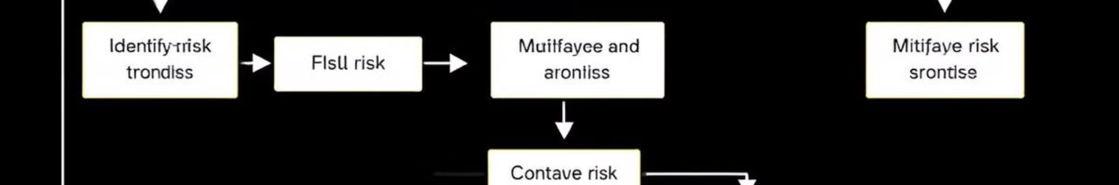
Risk assessment methodology and frameworks
Identify Risks
Mitigate Risks
Determine potential threats and vulnerabilities that could compromise data privacy.
Implement appropriate controls and safeguards to reduce the likelihood and impact of identified risks.
1
2
3
Analyze Risks
Assess the likelihood and impact of each risk, prioritizing those with higher potential consequences.

Slide 6
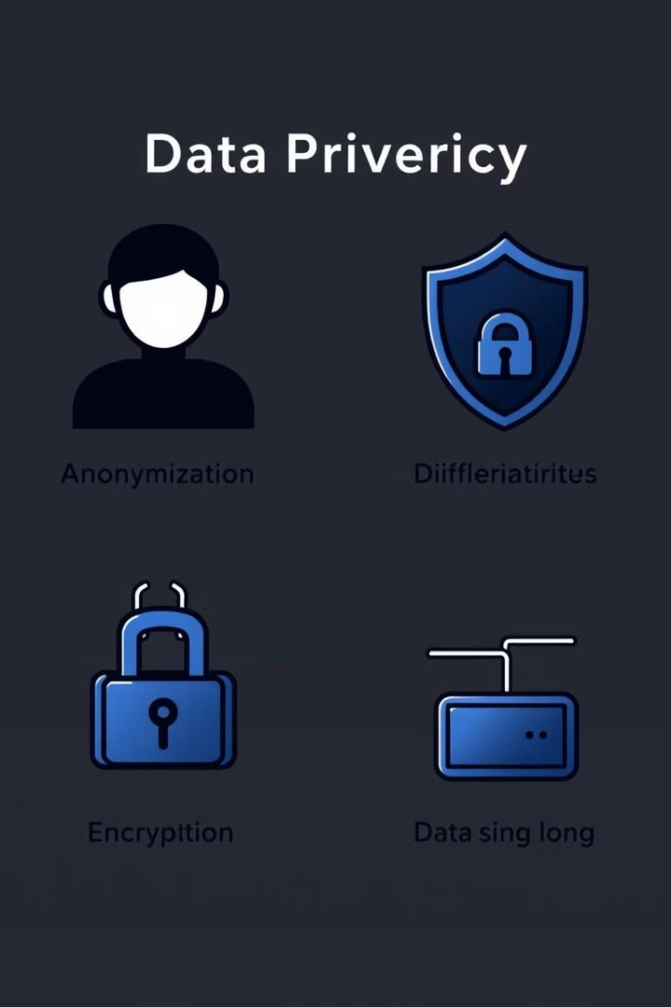
Privacy preservation techniques and technologies
Data Anonymization
Differential Privacy
Removing personally identifiable information to protect individual privacy.
Adding random noise to data to protect individual information while preserving statistical accuracy.
Encryption
Transforming data into an unreadable format, protecting it from unauthorized access.

Slide 7
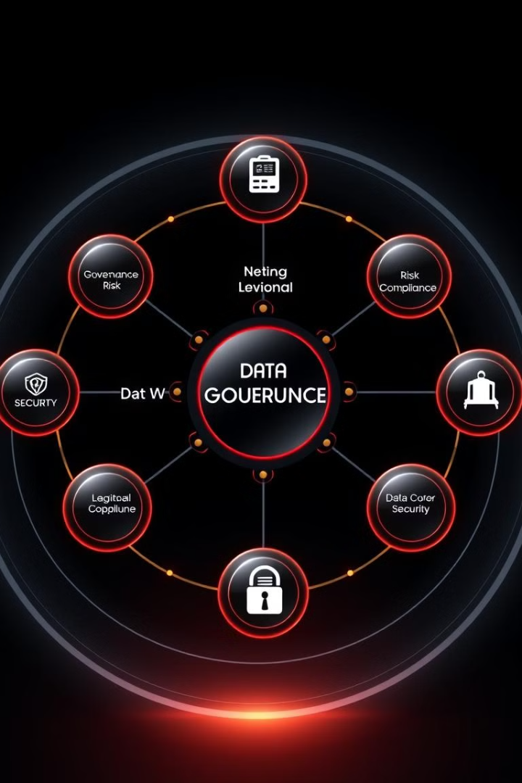




Developing a comprehensive risk assessment and compliance framework
Establish Data Governance
Develop clear policies and procedures for data management, including access control and data retention.
Conduct Risk Assessments
Regularly assess risks to data privacy and security, identifying vulnerabilities and mitigation strategies.
Implement Privacy-Preserving Technologies
Utilize techniques and technologies that protect data while enabling research.
Ensure Compliance
Monitor legal requirements and implement necessary controls to comply with applicable data privacy regulations.

Slide 8




Implementing the framework: case studies and lessons learned
Collaboration
Effective data sharing requires strong partnerships and coordinated efforts.
Transparency
Clear communication and accountability are crucial for building trust and fostering responsible data practices.
Innovation
Continuously evolve the framework to address emerging technologies and regulatory changes.

Slide 9
Conclusions
Data sharing is essential for advancing scientific understanding, but it must be balanced with robust protections for individual privacy. Addressing the risks to privacy and security while enabling collaboration is a critical challenge that requires a comprehensive framework and a commitment to ethical data practices.

